Slide 1

Achieving sustainability through stewardship
Looking at Projects through a new Lens
GORD-AFFUL, PMP | PMI
  26/07/2024

Slide 2

ACHIEVING SUSTAINABILITY THROUGH STEWARDSHIP: LOOKING AT PROJECTS THROUGH A NEW LENS
PRESENTED BY
Gord-afful, pmp
2024 NATIONAL
PROJECT MANAGEMENT
CONFERENCE

Slide 3
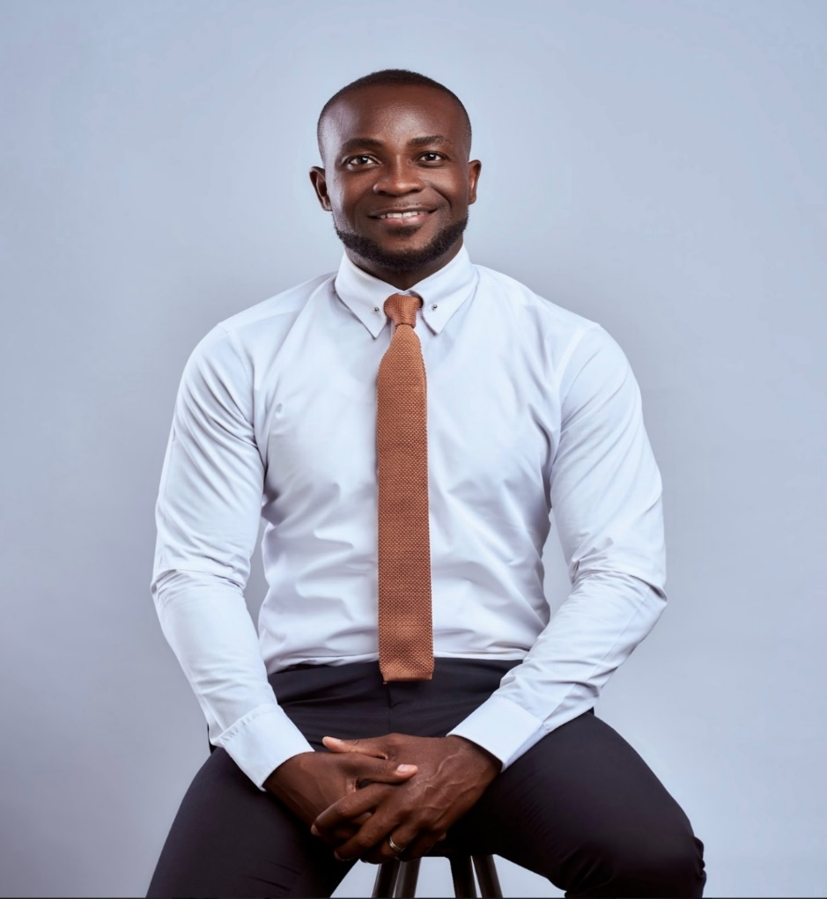

GORD-AFFUL, PMP, P2
AREAS OF EXPERTISE & INTEREST
PROJECT MANAGEMENT
LEADERSHIP
EDUCATIONAL NEUROSCIENCE
MONITORING & EVALUATION
ENTREPRENEURSHIP
HEALTH & SAFETY
PUBLIC/MOTIVATIONAL SPEAKING
YOUTH DEVELOPMENT & EMPOWERMENT

Slide 4
PRESENTATION PRECIS
INTRODUCTION
A LOOK AT SUSTAINABILITY IN PROJECT MANAGEMENT
THE NEW TITLE OF THE PROJECT MANAGER
THE ‘PULL’ MESSAGE OF THE MODERN PROJECT MANAGER
QUESTIONS

Slide 5
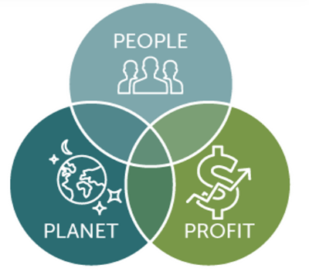
A LOOK AT SUSTAINABILITY IN PROJECT MANAGEMENT
The primary aim: to secure the future
Life today was dictated by the past; life tomorrow will be dictated by what we are doing today. What are we doing?
Delivering projects sustainably ( sustainable PM) means ensuring that our actions today do not limit the quality of life in the future
As projects seek to maximise Profits and value for the organisations. They should also seek to enhance the quality of life of the society (People) and protect the Environment (Plant)
Sustainability is about balancing the 3Ps or the Triple Bottom line

Slide 6


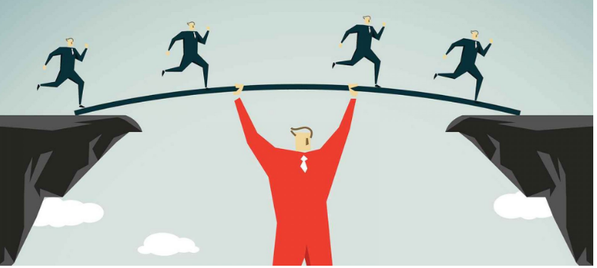
THE NEW TITLE OF THE PROJECT MANAGER
Names given to the Project Manager through history
  Before the 70s; the Profit Maker
  After 1970; the Leader; People Person
  21st Century; The STEWARD

Slide 7
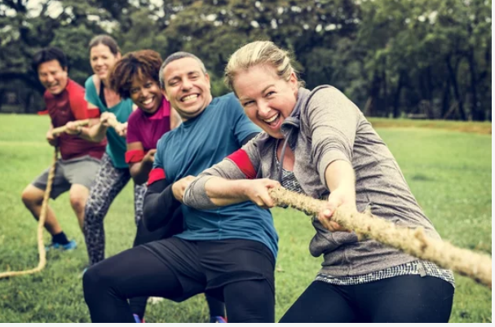
THE MESSAGE OF THE STEWARD
(Looking at projects through a new lens)
The ‘PULL’ message on Sustainability:
When it comes to Sustainability in PM:
  Promote it
  Understand it
  Leverage it
  Live it

Slide 8


PROMOTE SUSTAINABILITY
Be diligent, respectful, and caring
Maximise profits without ‘doing harm’
Purchase Sustainably ( Sustainable procurement)
Promote the 3Rs: Reuse, Reduce, Recycle
Reward efforts
Nurture Sustainability champions in various units
Be 3P-directed

Slide 9

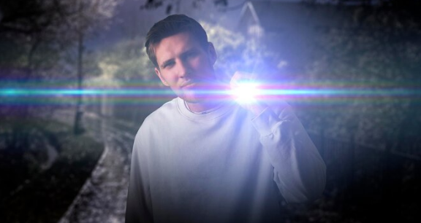
UNDERSTAND SUSTAINABILITY
Understand what Sustainability means
Understand the benefits, risks, and obligations
Identify key areas of application
Develop Sustainability Management Plan (SMP)
‘Keep the light on it’

Slide 10


LEVERAGE SUSTAINABILITY
Make it count in project proposals
Capitalise on opportunities identified
Maintain a customer-centric approach ( ‘customer survival thinking’)
Keep looking for opportunities
  “Thinking Sustainability opens doors of Opportunities”

Slide 11
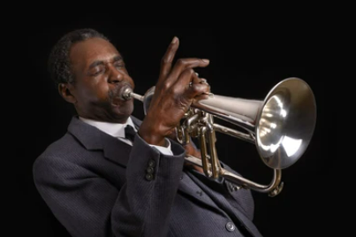
LIVE SUSTAINABILITY
Make it a culture
Motivation
Lead by example; be a good steward for the team
Nurture a goodish attitude and appetite for sustainability
Continuously PUL: Promote, Understand, Leverage

Slide 12
KEY TAKEAWAYS
Sustainability is just about the 3Ps or the Triple bottom line
There is a new title for the PM; there is a new cap for the PM
The PM has become a Project STEWARD
His message is simple: PULL Sustainability

Slide 13
MY QUESTION
WHAT WILL YOU DO DIFFERENTLY IN
YOUR ORGANISATION, BUSINESS OR PROJECT
AS A STEWARD?
IT’S TIME TO LOOK AT PROJECTS THROUGH THE LENS OF STEWARDSHIP

Slide 14
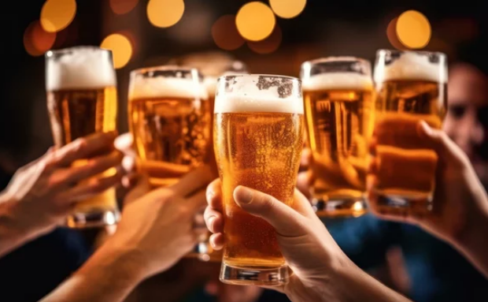
MY NAME IS GORD-AFFUL
Let’s do great things together

Slide 15

QUESTIONS

Slide 16
FOLLOW ME & I WILL FOLLOW BACK
LINKEDIN: GORD-AFFUL,PMP
INSTAGRAM: GORDAFFUL123
FACEBOOK: GORD-AFFUL, PMP
EMAIL: gordafful@gmail.com
CONTACT: 0558-57-34-22

Slide 17


